Slide 1


Chapter 5: Kubernetes for Continuous Integration
Agile Brains Consulting
1
©Agile Brains Consulting Inc. All rights reserved. Not to be reproduced without prior written consent.

Slide 2
Table of Content
Scaling and autoscaling
Deployment Strategies
Rolling update
Recreate
Blue Green
Canary
Service Discovery
GITOps integration

Slide 3
Zero Downtime Scaling
Agile Brains Consulting
3
©Agile Brains Consulting Inc. All rights reserved. Not to be reproduced without prior written consent.

Slide 4
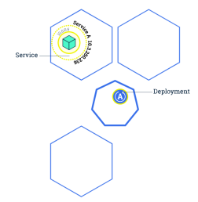
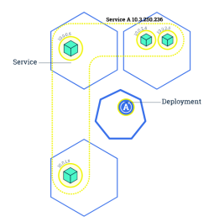
Kubernetes: Scaling
Changing the number of resources to meet a desired state
Accomplished by adjusting the number of replicas in a deployment
Accommodates both scaling up and scaling down to a minimum of 0
Traffic is automatically sent to newly created instances through the service load balancer
Can be used to enable rolling updates without downtime
Agile Brains Consulting
4
©Agile Brains Consulting Inc. All rights reserved. Not to be reproduced without prior written consent.

Slide 5
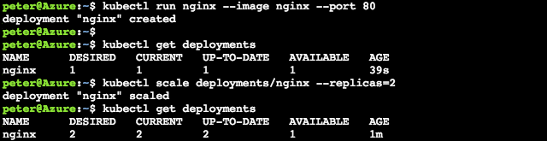
$ kubectl scale deployments/<deployment> --replicas=<new num>
$ kubectl scale deploy/nginx --replicas=4
Note: Make sure to delete the deployments or replicasets when trying to clear out pods. Many a new user has repeated deleted pods and gotten frustrated when they respawn (as the deployments/replicasets are programed to do).
Agile Brains Consulting
5
©Agile Brains Consulting Inc. All rights reserved. Not to be reproduced without prior written consent.
Notes:
kubectl run nginx –image nginx –port 80
kubectl get deployments
kubectl scale deployments/nginx –replicas=2
kubectl get deployments
http://kubernetesbyexample.com/labels/

Slide 6
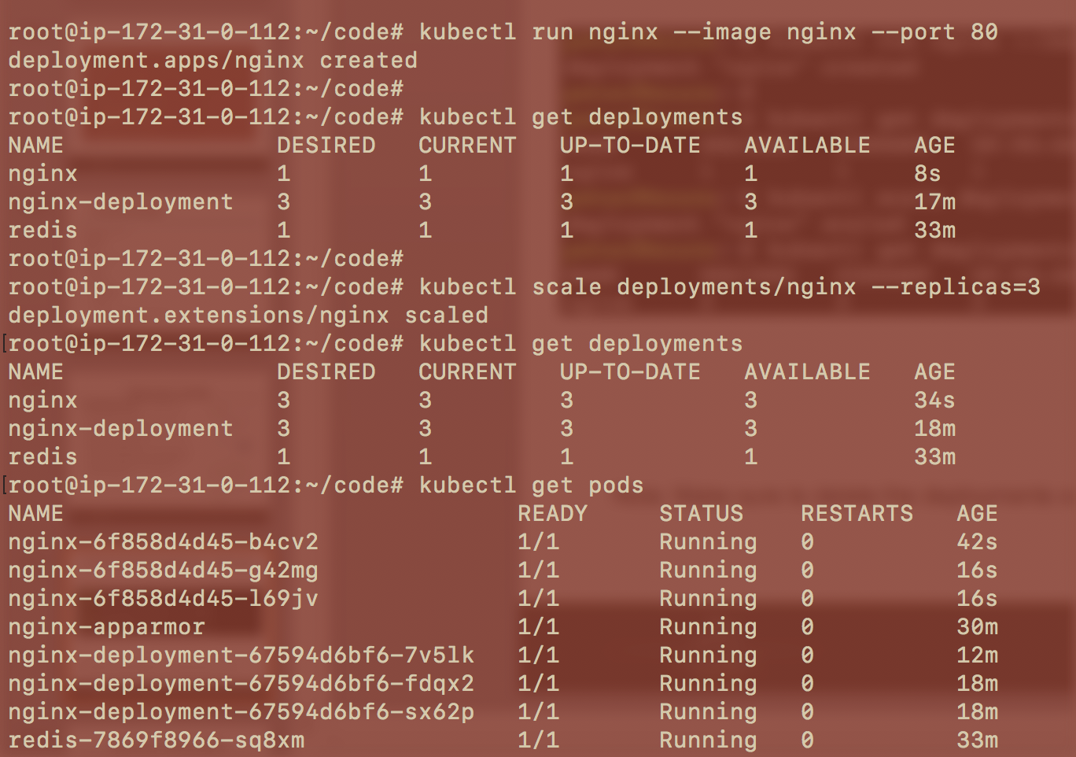
Agile Brains Consulting
6
©Agile Brains Consulting Inc. All rights reserved. Not to be reproduced without prior written consent.
Notes:
kubectl run nginx –image nginx –port 80
kubectl get deployments
kubectl scale deployments/nginx –replicas=2
kubectl get deployments
http://kubernetesbyexample.com/labels/

Slide 7
Autoscaling and HPA (Horizontal Pod Autoscaler)
Agile Brains Consulting
7
©Agile Brains Consulting Inc. All rights reserved. Not to be reproduced without prior written consent.

Slide 8
Kubernetes: AutoScaling
HPA – Horizontal Pod Autoscaler:
Based on memory and CPU utilization by a pod, autoscaling scales up or down the number of pods
$ kubectl autoscale deployment nginx --min=2 --max=10
$ kubectl autoscale deployment nginx-deployment --max=5 --cpu-percent=80
$ kubectl get hpa
$ kubectl get hpa
NAME REFERENCE TARGETS MINPODS MAXPODS REPLICAS AGE
nginx Deployment/nginx <unknown>/80% 1 4 3 12m
nginx-deployment Deployment/nginx-deployment <unknown>/80% 2 5 0 5s
Agile Brains Consulting
8
©Agile Brains Consulting Inc. All rights reserved. Not to be reproduced without prior written consent.

Slide 9
Continuous Deployment Strategies
Agile Brains Consulting
9
©Agile Brains Consulting Inc. All rights reserved. Not to be reproduced without prior written consent.

Slide 10
Strategies
Able to reliably and safely deploy, rollback and orchestrate software.
List of strategies:
Recreate
Ramped (Rolling update) Deployments
Blue/Green Deployments
Canary Releases
A/B Testing
Agile Brains Consulting
10
©Agile Brains Consulting Inc. All rights reserved. Not to be reproduced without prior written consent.

Slide 11
Strategies - Recreate
Recreate –
spec:
replicas: 3
selector:
matchLabels:
app: my-app
strategy:
type: Recreate
spec:
containers:
- name: my-app
image: my-image
terminate all the running instances then recreate them with the newer version
application state entirely renewed
not a true continuous deployment strategy
downtime
conceptual simplicity
Agile Brains Consulting
11
©Agile Brains Consulting Inc. All rights reserved. Not to be reproduced without prior written consent.

Slide 12
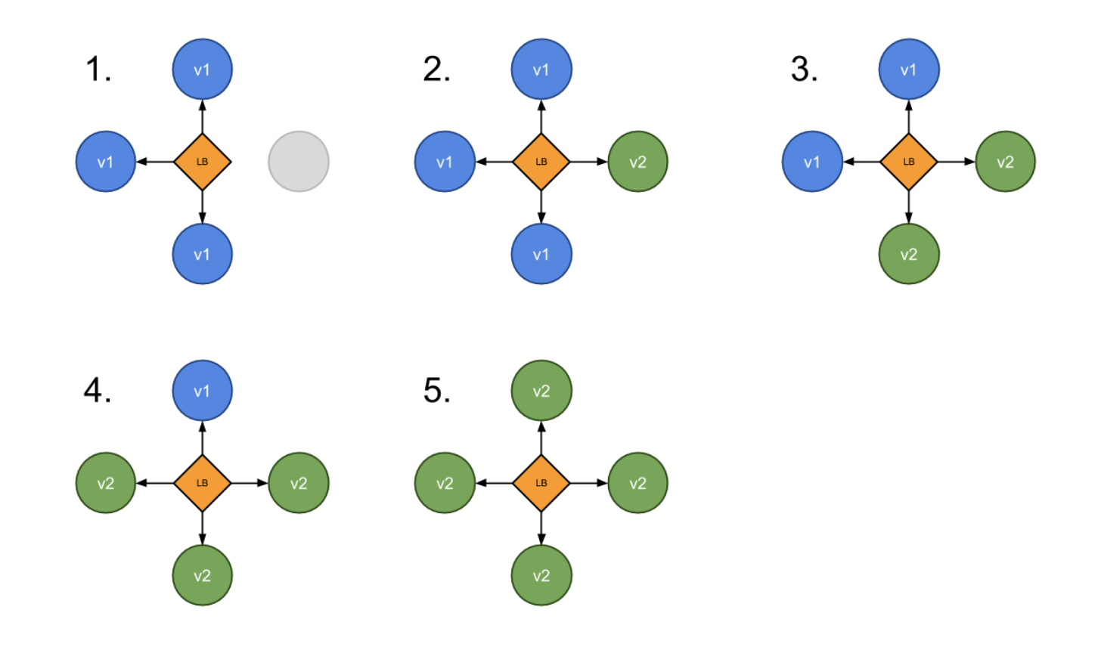
Strategies – Ramped or Rolling update
Ramped or Rolling Update
A secondary ReplicaSet is created with the new version of the application
The number of replicas of the old version is decreased and the new version is increased
Until the correct number of replicas is reached
Agile Brains Consulting
12
©Agile Brains Consulting Inc. All rights reserved. Not to be reproduced without prior written consent.

Slide 13
Strategies – Ramped or Rolling update
Best Practice
Should be accompanied by some kind of a basic health check
To verify the new instances are ready to provide services
To avoid downtime
Keep in mind
The old and the new version run side by side.
Requires full backward compatibility of our API and schema changes
Careful API versioning whenever backward compatibility gets broken.
If deployment exposed as service, the service will load-balance traffic to only active and available pods
Agile Brains Consulting
13
©Agile Brains Consulting Inc. All rights reserved. Not to be reproduced without prior written consent.

Slide 14
Strategies – Ramped or Rolling update
spec:
replicas: 3
strategy:
type: RollingUpdate
rollingUpdate:
maxSurge: 2 or x% # max number of pods can be created over desired
maxUnavailable: 1 or x% # define how many pods can be unavailable
containers: - image: nginx:2.0
readinessProbe: # when the container is ready to accept traffic httpGet: path: / port: 8080 initialDelaySeconds: 5 periodSeconds: 5 successThreshold: 1
Agile Brains Consulting
14
©Agile Brains Consulting Inc. All rights reserved. Not to be reproduced without prior written consent.

Slide 15
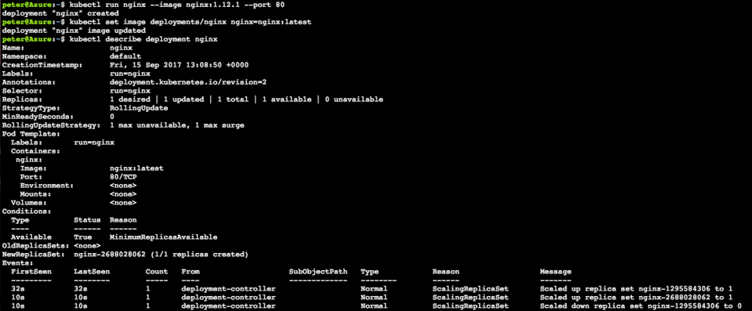
$ kubectl set image <deployment> <new-image>
Note: Rolling updates can also be undone
Agile Brains Consulting
15
©Agile Brains Consulting Inc. All rights reserved. Not to be reproduced without prior written consent.
Notes:
Stand up nginx but with an older version, 1.12.1
1. kubectl run nginx --image nginx:1.12.1 --port 80
Set image to the newer version (latest). This triggers kubernetes to begin a rolling update
2. kubectl set image deployments/nginx nginx=nginx:latest
Observe the newer image has been rolled out
3. kubectl describe deployment nginx

Slide 16
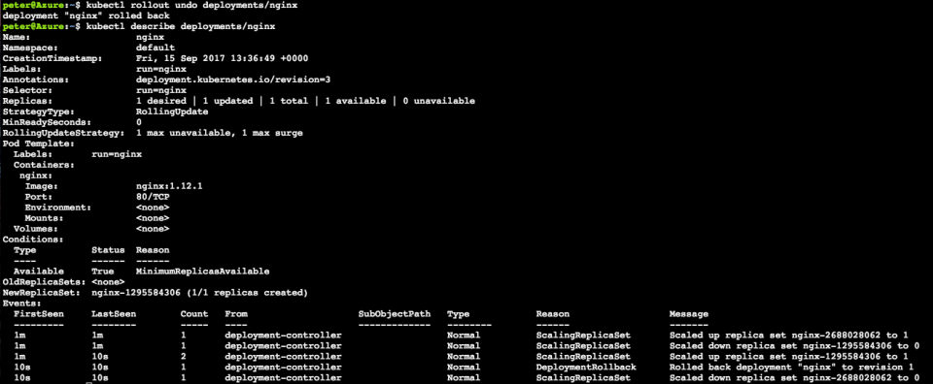
$ kubectl rollout undo <deployment>
Note: Rollbacks can also be also enacted with zero-downtime
Agile Brains Consulting
16
©Agile Brains Consulting Inc. All rights reserved. Not to be reproduced without prior written consent.
Notes:
Roll back to previous version nginx 1.12.1
4. kubectl rollout undo deployments/nginx
Observe changes
5. kubectl describe deployments/nginx

Slide 17
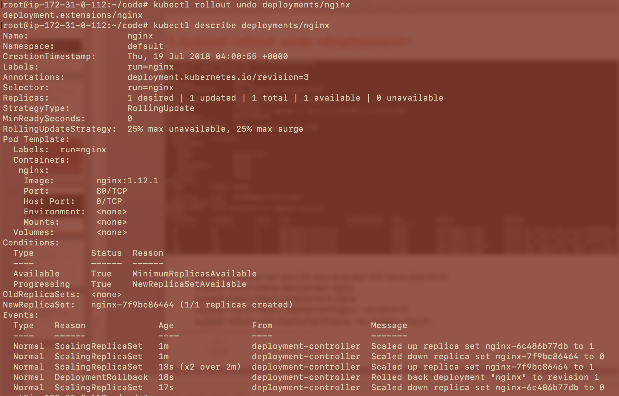
kubectl rollout status deployment nginx
kubectl rollout history deployment nginx
kubectl rollout history deployment/nginx --revision=3
kubectl rollout undo deployment/nginx --to-revision <num>
Agile Brains Consulting
17
©Agile Brains Consulting Inc. All rights reserved. Not to be reproduced without prior written consent.
Notes:
Roll back to previous version nginx 1.12.1
4. kubectl rollout undo deployments/nginx
Observe changes
5. kubectl describe deployments/nginx

Slide 18
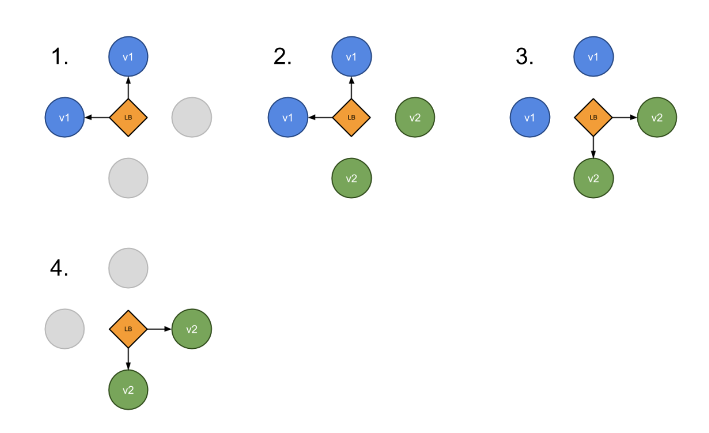
Strategies – Blue Green Deployment
“green” version is deployed alongside “blue”
Test the new version
Update the Service object (load balancer) to send traffic to the new version by replacing the version label in the selector field
Agile Brains Consulting
18
©Agile Brains Consulting Inc. All rights reserved. Not to be reproduced without prior written consent.

Slide 19
Strategies – Blue Green Deployment
(-)
Requires double the resources
Proper test of the entire platform
(+)
No downtime
Easy rollback
Steps to follow
v1 is serving traffic
deploy v2
wait until v2 is ready
switch incoming traffic from v1 to v2
shutdown v1
Agile Brains Consulting
19
©Agile Brains Consulting Inc. All rights reserved. Not to be reproduced without prior written consent.

Slide 20
kubectl apply -f my-dep-v1.yaml
kubectl apply -f my-dep-v2.yaml
my-dep v1
my-dep v2
After test
service
selector:
app: my-dep
version: v1
kubectl patch service my-app -p '{"spec":{"selector":{"version":"v2.0.0"}}}'
my-dep v2
my-dep v1
service
selector:
app: my-dep
version: v2

Slide 21
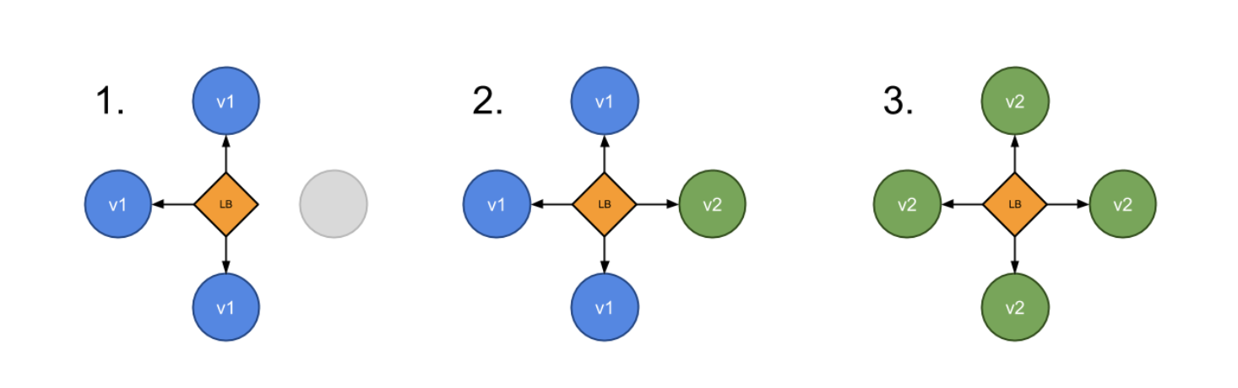
Strategies – Canary Deployment
Route a subset of users to a new functionality.
Can be done using two Deployments with common pod labels.
One replica of the new version is released alongside the old version
Then after some time and if no error is detected, scale up the number of replicas of the new version and delete the old deployment.
Agile Brains Consulting
21
©Agile Brains Consulting Inc. All rights reserved. Not to be reproduced without prior written consent.

Slide 22
Strategies – Canary Deployment
(-)
Slow rollout
(+)
Fast rollback
Good for error rate & performance monitoring
Steps to follow
10 replicas of v1 is serving traffic
deploy 1 replicas v2 (meaning ~10% of traffic)
Wait enough time to confirm that v2 is stable and not throwing unexpected errors
scale up v2 replicas to 10
wait until all instances are ready
shutdown v1
Agile Brains Consulting
22
©Agile Brains Consulting Inc. All rights reserved. Not to be reproduced without prior written consent.

Slide 23
kubectl apply -f my-dep-v1.yaml
kubectl apply -f my-dep-v2.yaml
my-dep v1
replica:10
my-dep v2
Replica:1
After sometime
selector:
app: my-dep
service
kubectl scale --replicas=10 deploy my-dep-v2
kubectl delete deploy my-dep-v1
my-dep v2
Replica:10
service
selector:
app: my-dep

Slide 24
Exercise 4 – (scaling, Auto scaling, rollout)
For a previously created deployment scale the number of replicas
see the difference in replicasets, pods , and see with a describe
Rolling update, undo and see the changes in replica sets
cd to the ex4
https://github.com/shekhar2010us/kubernetes_teach_git/blob/master/ex4/scaling_rolling.md
Agile Brains Consulting
24
©Agile Brains Consulting Inc. All rights reserved. Not to be reproduced without prior written consent.

Slide 25
Service Discovery
Agile Brains Consulting
25
©Agile Brains Consulting Inc. All rights reserved. Not to be reproduced without prior written consent.
Notes:
https://fredjean.net/kubernetes-discovery/

Slide 26
Service Discovery
Migrating from a monolithic architecture to a Microservices based architecture where each service loosely coupled and horizontally scaled will require a service discovery mechanism to ensure that the REST API endpoints of the ephemeral services (say, docker containers running inside PODs) are resolved or detected. The IP addresses of the containers (or the PODs) being transient will need automated mechanism to resolve or convey the current IP addresses.
Agile Brains Consulting
26
©Agile Brains Consulting Inc. All rights reserved. Not to be reproduced without prior written consent.
Notes:
https://fredjean.net/kubernetes-discovery/

Slide 27
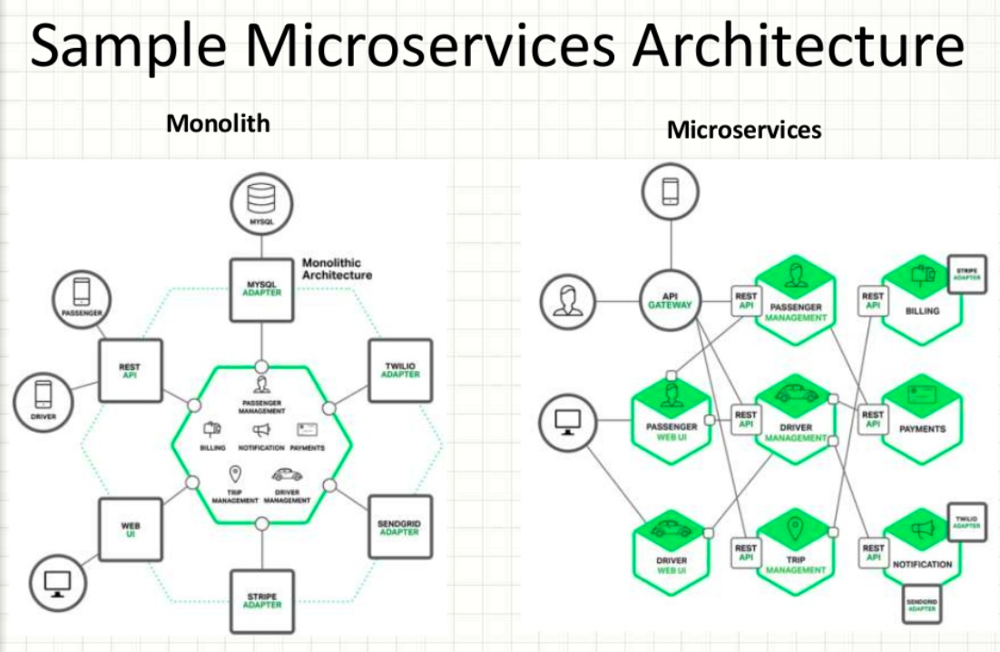
Agile Brains Consulting
27
©Agile Brains Consulting Inc. All rights reserved. Not to be reproduced without prior written consent.

Slide 28
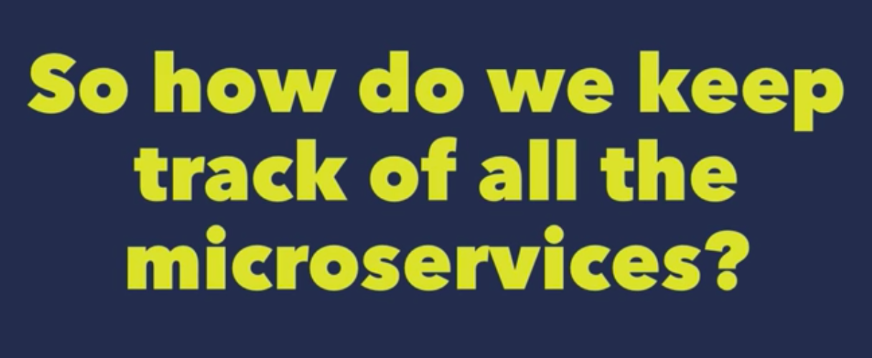
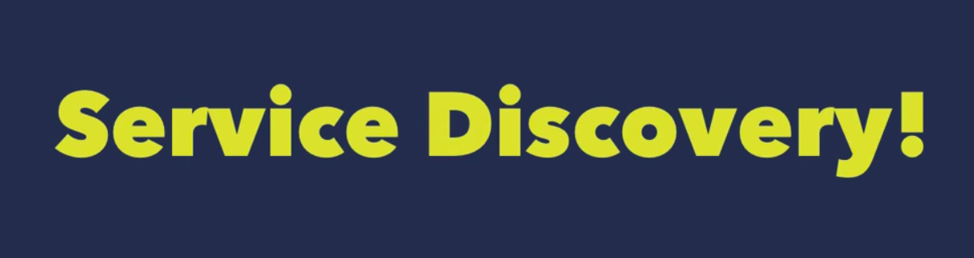
Service Discovery
Agile Brains Consulting
28
©Agile Brains Consulting Inc. All rights reserved. Not to be reproduced without prior written consent.
Notes:
https://fredjean.net/kubernetes-discovery/

Slide 29
Service Discovery
What should Service Discovery provide?
Discover services dynamically to get IP address and port details to communicate with other services
Health check: Only healthy services should participate in handling traffic
Load balancing: Traffic destined to a particular service should be dynamically load balanced
Agile Brains Consulting
29
©Agile Brains Consulting Inc. All rights reserved. Not to be reproduced without prior written consent.

Slide 30
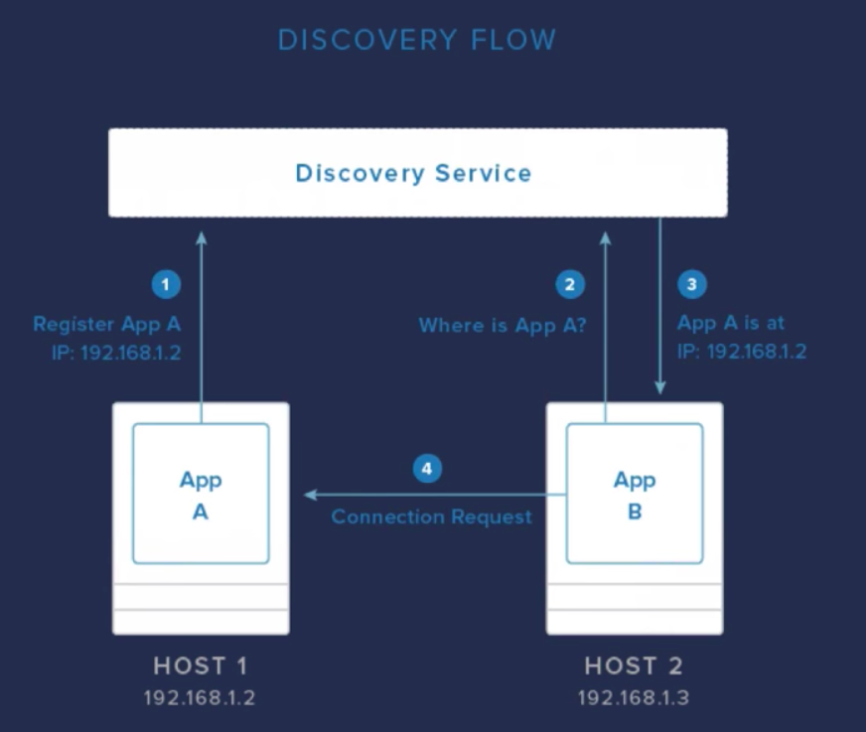
Service Discovery
Agile Brains Consulting
30
©Agile Brains Consulting Inc. All rights reserved. Not to be reproduced without prior written consent.
Notes:
https://fredjean.net/kubernetes-discovery/

Slide 31
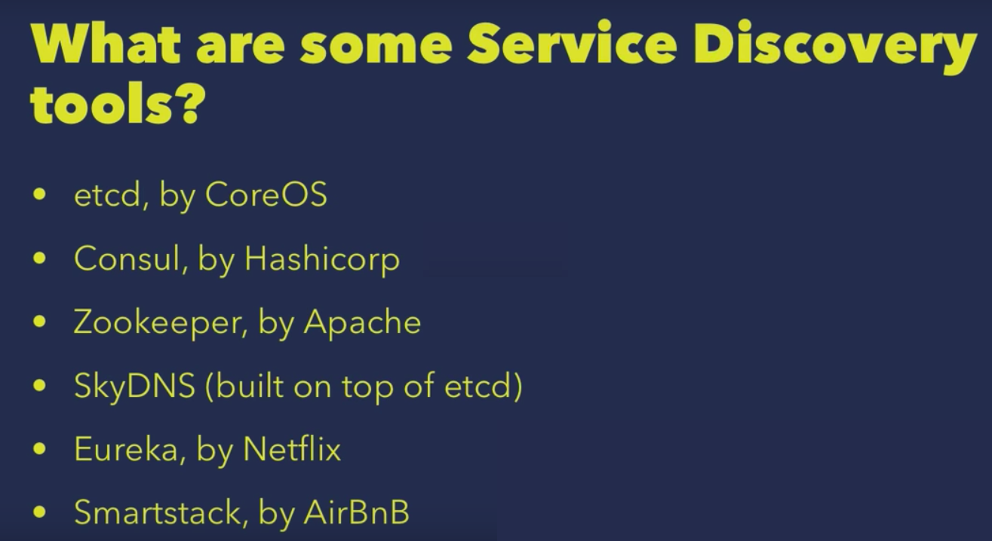
Service Discovery Tools
Agile Brains Consulting
31
©Agile Brains Consulting Inc. All rights reserved. Not to be reproduced without prior written consent.
Notes:
https://fredjean.net/kubernetes-discovery/

Slide 32
Service Discovery by etcd
Etcd can be used as KV store for service registry
Service itself can directly update etcd or a Sidekick service can be used to update etcd
Sidekick service serves as registrator
Other services can query etcd database to do the dynamic service discovery
service
service
service
service
sidekick
etcd
Agile Brains Consulting
32
©Agile Brains Consulting Inc. All rights reserved. Not to be reproduced without prior written consent.

Slide 33
Service Discovery by HashiCorp (Consul)
Consul is a distributed, HA service discovery and configuration system
Consul provides features - includes service and node discovery mechanisms, tagging system, health checks, consensus-based election routines, system-wide key/value storage, etc.
Provides Rest based HTTP Api for external interaction
Agile Brains Consulting
33
©Agile Brains Consulting Inc. All rights reserved. Not to be reproduced without prior written consent.
Notes:
https://www.digitalocean.com/community/tutorials/an-introduction-to-using-consul-a-service-discovery-system-on-ubuntu-14-04

Slide 34
Service Discovery – Zookeeper by Apache
Apache ZooKeeper is a distributed, open-source coordination service for distributed applications.
Allows to read, write, and observe updates to data.
Data are organized in a file system like hierarchy and replicated to all ZooKeeper servers in the ensemble (a set of ZooKeeper servers).
Operations on data are atomic and sequentially consistent
Agile Brains Consulting
34
©Agile Brains Consulting Inc. All rights reserved. Not to be reproduced without prior written consent.

Slide 35
Kubernetes Service Discovery
Using the environment variables that use the same conventions as those created by Docker links. Using DNS to resolve the service names to the service’s IP address.
1. Environment Variables
Kubernetes injects environment variables for each service and each port exposed by the service. This makes it easy to deploy containers that use Docker links to find their dependencies.
For example, a RabbitMQ service can be located by using the RABBITMQ_SERVICE_SERVICE_HOST and RABBIT_MP_SERVICE_SERVICE_PORT variables. Other environment variables are also exposed to support this.
Agile Brains Consulting
35
©Agile Brains Consulting Inc. All rights reserved. Not to be reproduced without prior written consent.

Slide 36
Kubernetes Service Discovery
DNS Resolution
Kubernetes has a kube-dns addon that exposes the service’s name as a DNS entry. As a result, you can tell your application to connect to a host name.
The service names are scoped within namespaces. This allows you to run different deployment of a service for each namespace (for example, one per developer or one per environments) without having to edit configuration files.
Agile Brains Consulting
36
©Agile Brains Consulting Inc. All rights reserved. Not to be reproduced without prior written consent.
Notes:
https://fredjean.net/kubernetes-discovery/

Slide 37
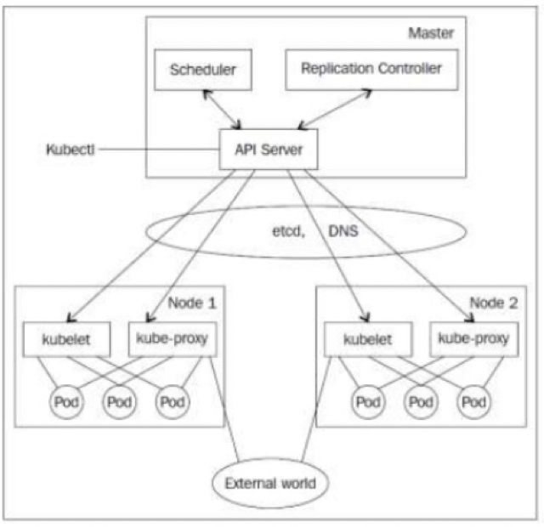
K8s Service Discovery Components
SkyDNS – map Service name to IP address
Etcd – KV store for service database
Kubelet – healthcheck and replication controller takes care of maintaining pod count
Kube-proxy – takes care of load balancing traffic to individual pods. Watches service changes and updates IPTables
Agile Brains Consulting
37
©Agile Brains Consulting Inc. All rights reserved. Not to be reproduced without prior written consent.

Slide 38
Service Discovery
{
"kind": "Service",
"apiVersion": "v1",
"metadata": {"name": "my-service"},
"spec": {
"selector":{"app": "MyApp"},
"ports":[
{
"protocol":"TCP",
"port":80,
"targetPort":9376
}
]
}
}
Services – get mapped to pods using Selector labels. In the example: “MyApp” is the label
Service port gets mapped to targetPort in the pod
Agile Brains Consulting
38
©Agile Brains Consulting Inc. All rights reserved. Not to be reproduced without prior written consent.

Slide 39
Lab: Service Discovery
https://github.com/shekhar2010us/kubernetes_teach_git/blob/master/k8s_service_discovery/service-discovery.md
Example using consul:
https://github.com/hashicorp/demo-consul-101/tree/master/k8s
Agile Brains Consulting
39
©Agile Brains Consulting Inc. All rights reserved. Not to be reproduced without prior written consent.

Slide 40
CICD (Jenkins) Integration with Kubernetes
Agile Brains Consulting
40
©Agile Brains Consulting Inc. All rights reserved. Not to be reproduced without prior written consent.

Slide 41
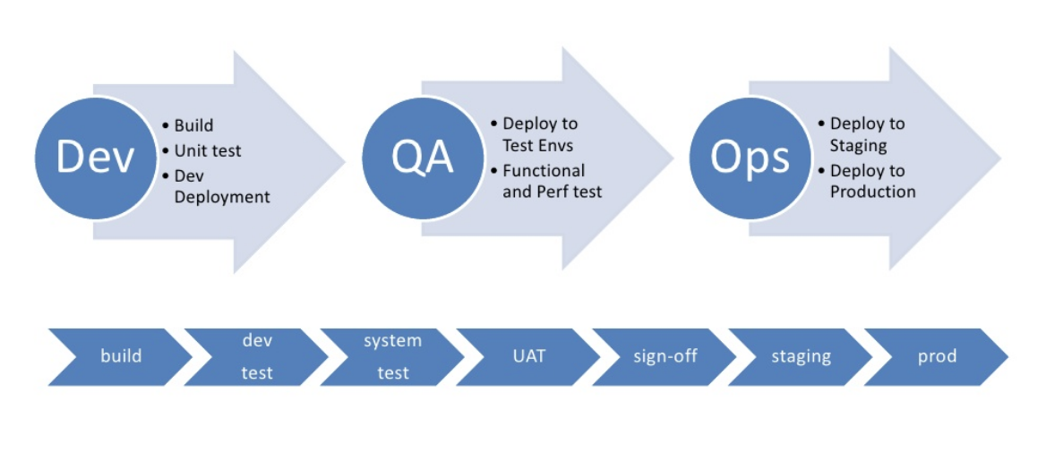
Introduction to CI/CD
What is a Pipeline
Agile Brains Consulting
41
©Agile Brains Consulting Inc. All rights reserved. Not to be reproduced without prior written consent.

Slide 42
Continuous Integration: Benefits
Reduced integration risk. More often than not, working on projects means multiple people are working on the separate tasks or parts of the code. The more people, the riskier the integration. Depending on how bad the problem really is, debugging and solving the issue can be really painful and can potentially mean a lot of changes to the code. Integrating on a daily basis or even more frequently can help reduce these kinds of problems to a minimum.
Higher code quality. Not having to worry about the problems, and focusing more on the functionality of the code results in a higher quality product.
The code in version control works. If you commit something that breaks the build, you and your team get the notice immediately and the problem is fixed before anyone else pulls the “broken” code.
Less time deploying. Deploying projects can be very tedious and time-consuming, and automating that process makes perfect sense
Agile Brains Consulting
42
©Agile Brains Consulting Inc. All rights reserved. Not to be reproduced without prior written consent.

Slide 43
Continuous Integration: Requirements
VCS: The first requirement is having the version control system (VCS). There is no way around it and there shouldn’t be a way around it. VCS provides a reliable method to centralize and preserve changes made to your project over time. (Git)
CI Server: Continuous integration server (aka build server, aka CI server) is a software tool that centralizes all your CI operations and provides a reliable and stable environment for you to build your projects on.(Jenkins)
Agile Brains Consulting
43
©Agile Brains Consulting Inc. All rights reserved. Not to be reproduced without prior written consent.

Slide 44

Jenkins is an open source automation server written in Java. Jenkins helps to automate the non-human part of software development process, with continuous integration and continuous delivery/continuos deployment.
Agile Brains Consulting
44
©Agile Brains Consulting Inc. All rights reserved. Not to be reproduced without prior written consent.

Slide 45
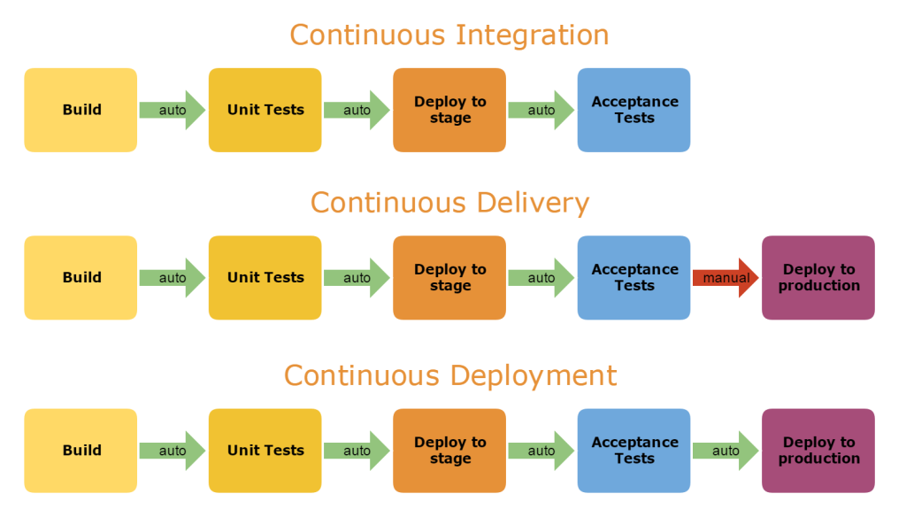
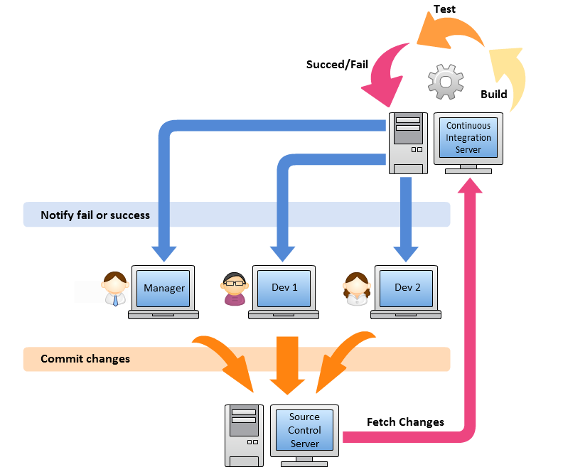
Agile Brains Consulting
45
©Agile Brains Consulting Inc. All rights reserved. Not to be reproduced without prior written consent.

Slide 46
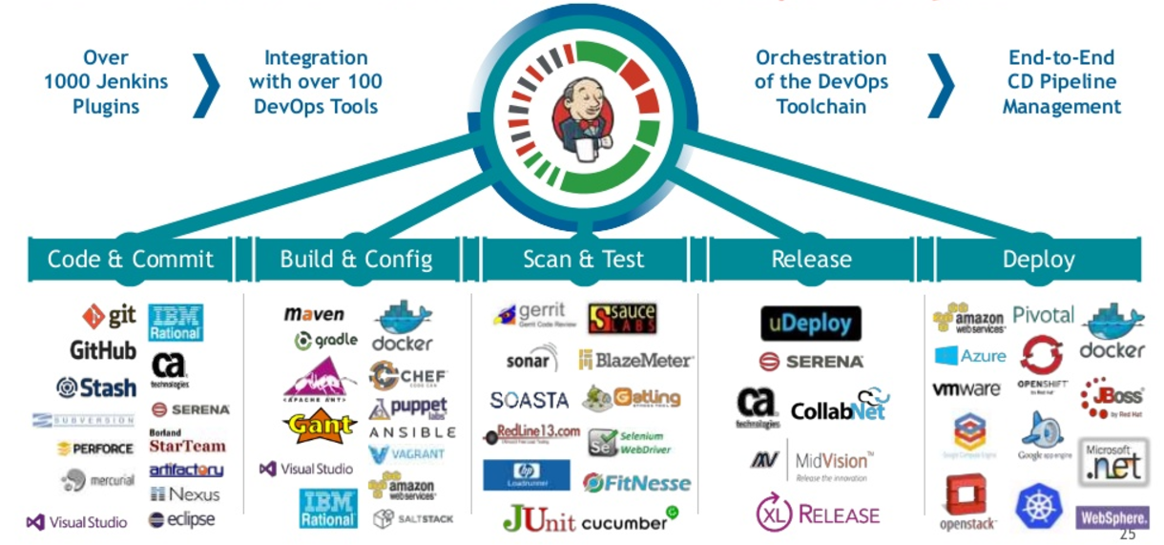
Agile Brains Consulting
46
©Agile Brains Consulting Inc. All rights reserved. Not to be reproduced without prior written consent.

Slide 47
Deploy Jenkins in Kubernetes
https://github.com/jenkinsci/kubernetes-cd-plugin/blob/dev/README.md
https://medium.com/containerum/configuring-ci-cd-on-kubernetes-with-jenkins-89eab7234270
https://kubernetes.io/blog/2018/04/30/zero-downtime-deployment-kubernetes-jenkins/

